Slide 1
大系统时代前沿研究探索：网络和智能之深度融合
周礼栋
微软亚洲研究院

Slide 2



云计算，大数据，人工智能时代？

Slide 3

大网络系统时代

Slide 4
新大网络系统时代的机会和挑战
硬件多样异构型
超大规模复杂系统和网络
人工智能和系统网络的融合

Slide 5
网络、系统和智能之深度融合
高复杂性下的系统和网络可靠性
人工智能系统中对网络设计重新思考

Slide 6
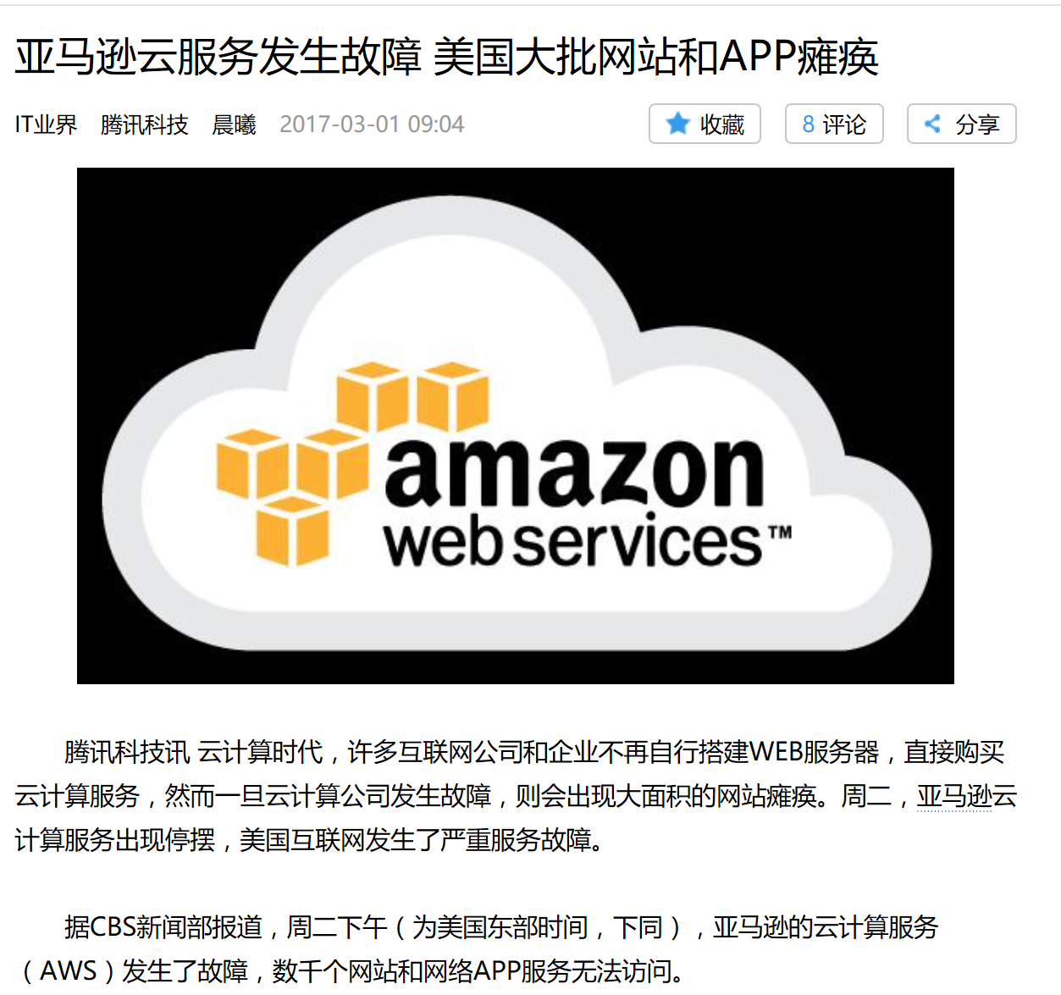
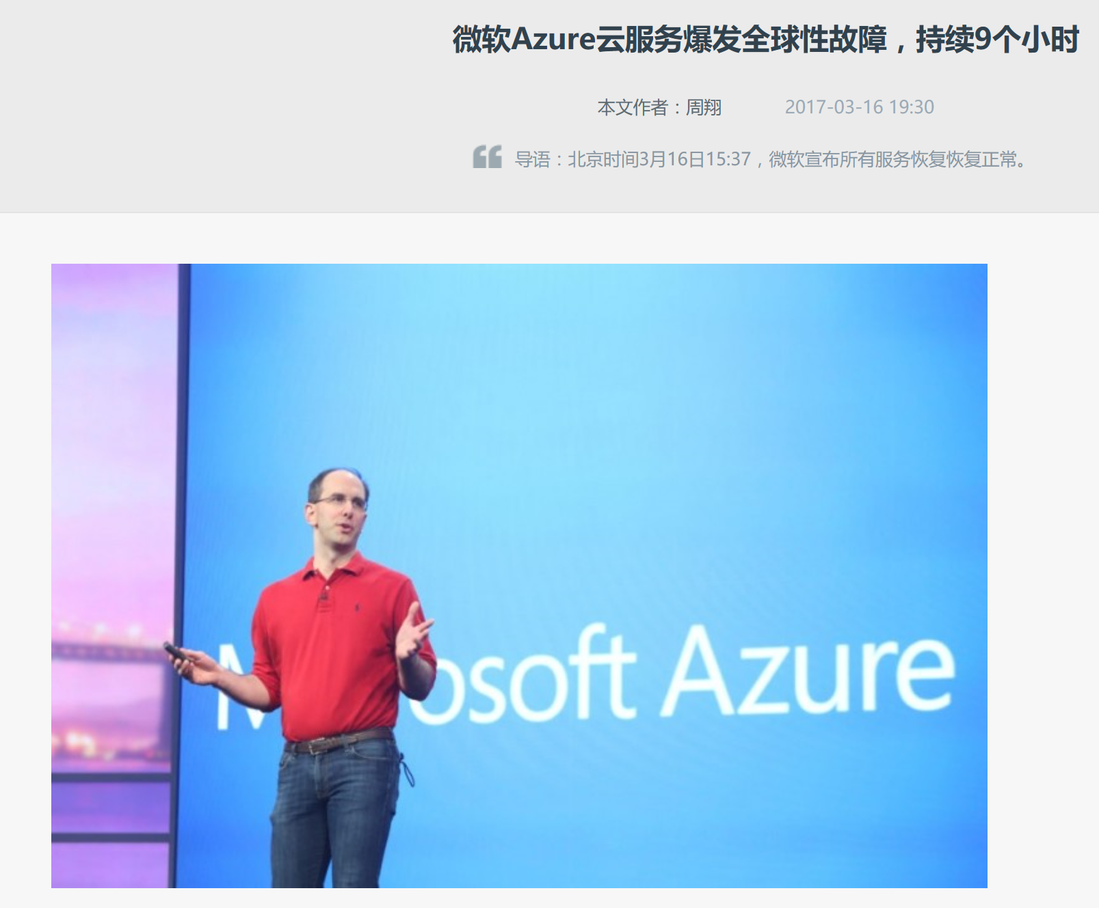


大规模网络系统可靠性的挑战

Slide 7

灰色故障
symptom
subtle and ambiguous: e.g., switch random packet loss, non-fatal exceptions, memory thrashing, flaky disk I/O, overload..
A component either works correctly or stops
A component appears to be still working but is in fact experiencing severe issue
A component may behave arbitrarily
Fail-stop
Gray failure
Byzantine
occurrence
process pair
TMR
PBFT
Zyzzyva
across s/w and h/w stack in the infra due to various defects
behind most service incidents we’ve seen in Azure
RAID
primary backup
Q/U
BAR Gossip
2PC
chain replication
Aliph
UpRight
danger
…
Paxos
erasure coding
fault-tolerance ineffective or counterproductive
faults take engineers & designers huge efforts to nail down
teams play the blame game with each other
virtual synchrony
Zab
…

Slide 8
Azure云系统中的灰色故障实例

Slide 9
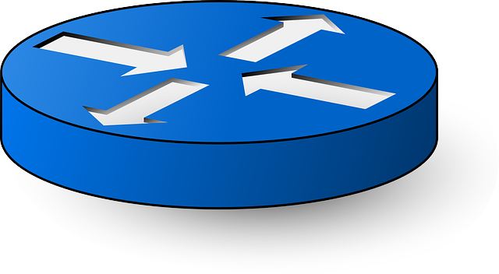
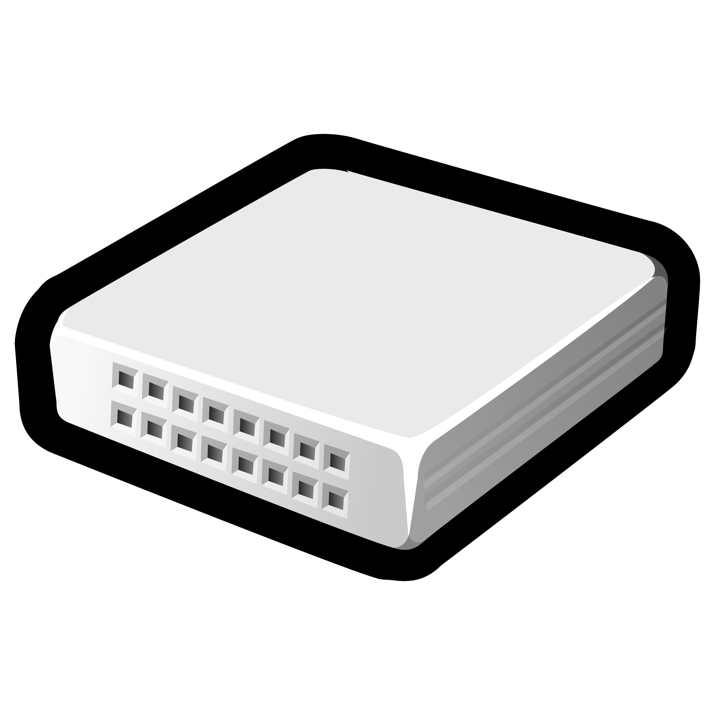

数据中心网络中的冗余
increasing # of core switches helps with availability
crash
Core
r₁
r₂
Aggregation
ToR
A
B

Slide 10

灰色故障下增加冗余可能反而有害
high chance to involve every core switches for each front-end request
gray failure at any core switch will cause delay
more core switches worse tail latencies
$$1−{(1−p)}^{n}$$
random packet drop
Core
r₁
r₂
r₃
r₄
Aggregation
ToR
A
B
C
D
E
Workload: send multiple requests
wait for all to finish (e.g., search)

Slide 11
利用系统的大规模解决大规模带来的挑战
建立更完整全面的观察，而不是单一的点
利用统计学，特定领域的知识，以及合适的人工智能算法来发现并定位问题

Slide 12
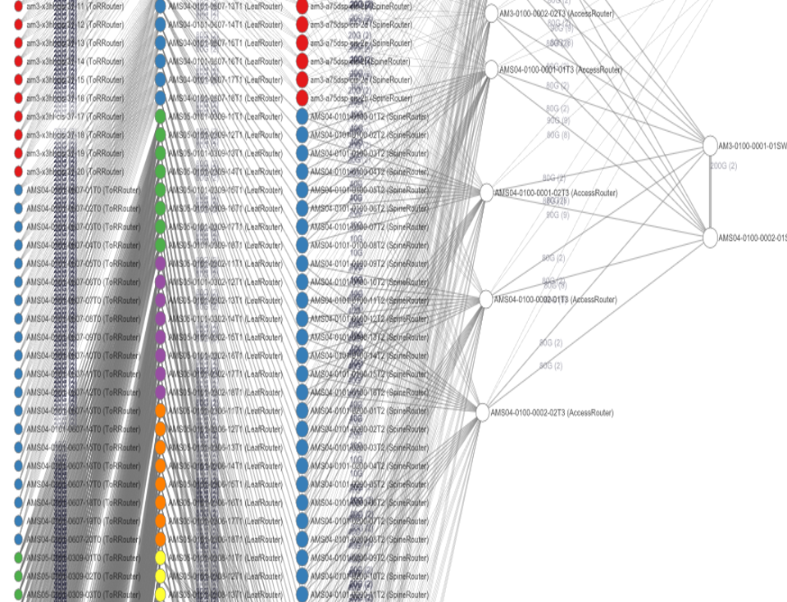
数据中心网络设备和链接的故障检测
Network
Hundreds of thousands of switches and routers; millions of links.
FC
Compute Rack
Storage Rack
FC
VM
VM
VM
Front End
…
…
…
…
Partition
Server
Extent
Node
Compute Clusters
Storage Clusters
Any of them can fail at any time!

Slide 13
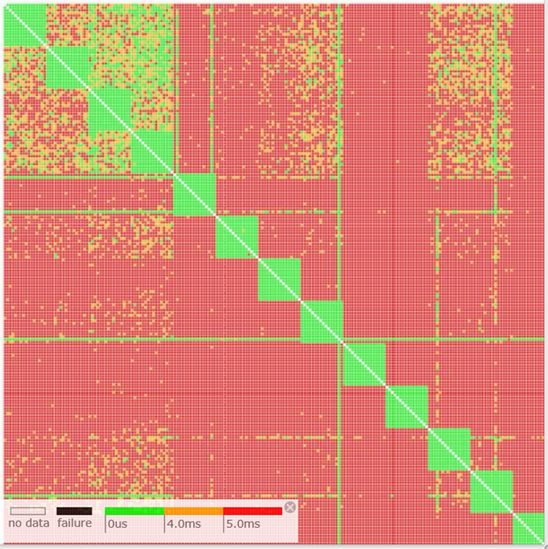
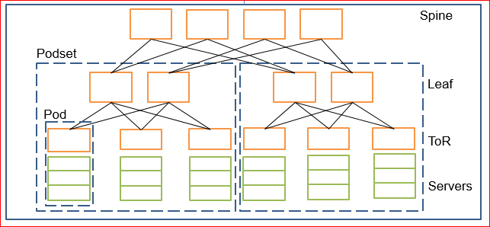
网络连接故障定位的挑战
Which link/switch is the culprit?

Slide 14
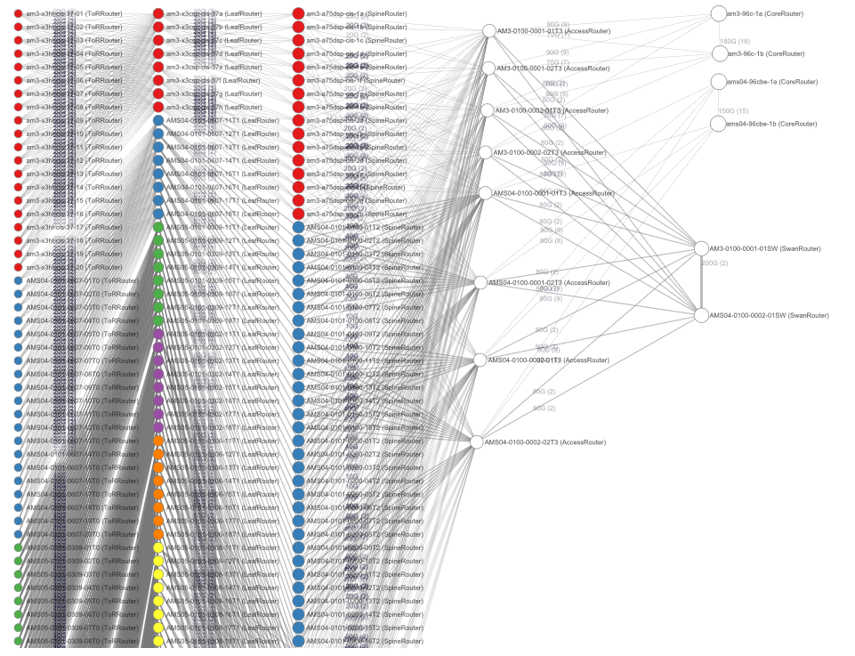
Notes:
However, this is a hard problem.
One thing makes it complicated, in a large-scale data center network, is that there are too many paths available between two servers.
For one TCP retransmission, let’s say, you don’t necessary know where the failure happened.

Slide 15
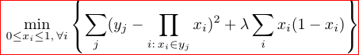
NetBouncer: 大规模探测和采集路径情况
Use IP-in-IP technique to explicitly probe all possible paths
Infer link failure from path failure
divide and conquer, solving equations (foundation)
most paths are good (intuition)
inconsistent data (challenge)
Joint Work with Cheng Tan, Ze Jin, Chuanxiong Guo, Ryan Huang, Tianrong Zhang, Haitao Wu, Karl Deng, Shalabh Jain, Dongming Bi, Dong Xiang, Jay Lorch

Slide 16
为什么故障定位是个难题？
Spine
x?
x?
x?
Leaf
x?
x?
x?
x?
ToR
…
?
Nothing
Servers
Notes:
To be more specific, here is a simplified data center network. [Each circle is a server and each rectangular is a network switch.]
Suppose we have two servers who want to talk to each other.
As shown in the network, there are many equal cost paths that the packet might take.
If one packet get sent by the sender, but doesn’t receive by the receiver.
We don’t quite know which link or even path should be responsible for this packet loss.

Slide 17
传统监控系统
Spine
Query the switch (SNMP)
Leaf
Everything OK?
ToR
…
…
?
Nothing
Servers
Notes:
Traditional monitoring system solves this problem by querying the switch asking if there is anything wrong, using protocols like SNMP.
Hopefully, if we asked all the switches, we will get a global view of the status of the whole network.
%If one switch does not even response, we think it is down.
%And, we can query the packet loss rate for one link to consider it as healthy or faulty.

Slide 18
传统监控系统的短板
Spine
Silent packet drop
Leaf
ToR
…
…
?
Nothing
Servers
Notes:
However, traditional monitoring systems are not enough.
In reality, we have met the those failures that they cannot detect.
Here is this silent packet drop example. Again, the packet lost somewhere.
However, traditional monitoring system told us that everything was fine.
The reality is there is a silent packet drop due to some firmware bugs.
I have to say such silent packet drops are very infrequent, around ten cases per month in our data center.
However, their influences can be significant. Essentially, operators met a scenario that the network
suffers from packet loss but everything seems fine.

Slide 19
传统监控系统无法应对灰色故障
Spine
Gray failures
Leaf
ToR
…
…
?
Nothing
Servers

Slide 20
Problem statement: from path to link
For troubleshooting, developers need to know which links/devices fail.
From the observation, we only have end-to-end path failures.
Questions:
Is it possible to infer link failures from path failures?
What are the challenges in real-world datacenter?
Notes:
We only have end-to-end measurement i.e. path.
Why “in theory”, what if we ignore theory, just do it?
Qustions:
In theory, can we do from path to link infer?
Even if it works in theory, what are the practical challenges?

Slide 21



NetBouncer
NetBouncer is an active probing system which infers failures from path probing data.
NetBouncer is an active probing system which infers failures from path probing data.
NetBouncer is an active probing system which infers failures from path probing data.
NetBouncer is an active probing system which infers failures from path probing data.
Spine
Leaf
…
ToR
Servers
…
Probing plan
Path probing data
Controller
Link failure
Processor
Network
topology
Device failure
Notes:
NetBouncer is an active probing system which infers failures from path probing data.
By active probing, I mean the servers will actively sending probing packet to the network and record the number of sent and received packets to detect failure.
As to the problem, which path to probe, there is an central controller which takes network topology as input, and outputs these probing plans, which contains for each of the server, which path it should probe.
And finally, there is a processor collecting these path probing data and runs an algorithm to pinpoint the link and device failures.
This overview leads to the outline of the rest of my talk.

Slide 22
NetBouncer 技术总结
A model that learns local link failures from end-to-end measurements
Integrates machine learning with networking domain knowledge
With proven mathematical foundation
Handles real-world data inconsistency
A working prototype
Works on Azure clusters
Handles 100+GB/hour throughput

Slide 23
NetBouncer pipeline
NetBouncer Controller
Control plane
Agent
Agent
Real-time processor
Agent
Agent
Agent
Agent
Agent
Detect link/device failures
Fix suspicious links
NetBouncer Agents
Probe the paths
Notes:
Have a system implementation. A figure to show the whole system architecture.
Netbouncer agent, netbouncer controller, and real-time streaming processing pipeline which Mohamed has presented.

Slide 24
网络故障定位系统的需求
Share the end-hosts’ perspective
SNMP, OpenFlow (overlooking failures)
Extremely light weight
NetSight, EverFlow (overhead on network traffic and switch CPU)
Compatible with commodity hardware and current software stack
LossRadar (hardware support)
Trumpet (modify hypervisor)
Passive probing (occupy packet QoS bits)
Notes:
in order to detect the failures like the silent packet drops,
The failure localization system should share the end-hosts’ perspective.
So that it will not miss the packet loss seen by the servers.
Second, a failure localization system working in the data center must be extremely light weight, in term of network traffic, switch CPU cost and server CPU cost.
DCN is an performance sensitive environment. Even 1% overhead will be a problem
Finally, it needs to be compatible with hardware.
This might not be so strict for research systems, but this is *crucial* in production. If you want to modify an existing core component for serving your system, your system may never be deployed.
These requirements motivates our NetBouncer system.

Slide 25
主要技术挑战
1
How to achieve light-weight and explicit probing?
…
…
2
How to design a probing plan?
3
How to infer the device and link failures from path probing data?
Notes:
First, I will describe how to achieve light-weight path probing.
Then, I will explain how NetBouncer design an eligible probing plan. At that time I will rigorously define what is “eligible probing plan”.
But, for now, intuitively, the probing plan should cover all links and more importantly the paths should contain enough information to distinguish the status of every single link.
Finally, I will introduce our algorithm to infer the link failures from path probing data.

Slide 26
IP-in-IP 基础
Traditional probing: ping (unknown path) and tracert (costly)
NetBouncer uses IP-in-IP to explicitly probe a path.
IP-in-IP forwarding is implemented in hardware.
dst: swtich₁
dst: swtich₂
payload
Server
Switch₁
Switch₂
Notes:
As an active probing system, NB cannot use
traditional probing methods, such as ping and tracert, because they cannot satisfy our requirements.
Ping doesn’t explicitly pinpoint a path, and tracert is too costly.
NetBouncer uses a technique called IP-in-IP to achieve efficient and explicit path probing.
IP-in-IP is a technique that wrap an IP header in another IP header.
Here is a simple example, that server want to deliver the payload to switch2 through switch1.
It first construct a IP header whose destination is switch2 and then wrap an outer IP header whose destination is switch1.
The packet will be routed to switch1 and after decapsulating the header, siwtch1 find the next hop is switch2 and it will
Forward the packet to switch2.
This IP-in-IP forwarding logic is implemented in hardware.
So, it is cheap without involving switch’s CPUs.

Slide 27
Probing strategy: packet bouncing
…
The server asks a switch to “bounce back” the packet.
Simpler model,
simpler implementation,
and simpler design for fault tolerance.
Notes:
On top of IP-in-IP technique, NetBoucner uses a probing strategy called packet bouncing.
It means the server asks a switch to bouce back the packet, like this example.
This packet bouncing provides us a simpler model.
Because every path is evaluated bi-directional, so we can use undirected graph as our model, which we will see later.
And, it simplifies our implementation. Because of the characteristics of Clos network, there is only one shortest path from server to one switch.
So, NetBouncer only has to prepare one inner IP-header to implement the packet bouncing.
Finally, packet bouncing simplifies the fault tolerance. Because the sender and receiver are the same server, the probing data for one path is maintained by the same server.
So, the probing data are all or nothing to the processor. Either processor receives the data or doesn’t even know their existence.
However, if sender and receiver are different servers, there must be some kinds of synchronization between servers to make sure the consistency of the data.
OK, this is how NB achieves efficient probing.

Slide 28
Model the problem
y₁ = 100%
y₂ = 50%
Spine
Spine
X₃
X₆
Leaf
Leaf
X₂
X₅=50%
ToR
ToR
X₁=100%
X₄
Servers
Servers
Notes:
Note: we know y, to calculate x

Slide 29
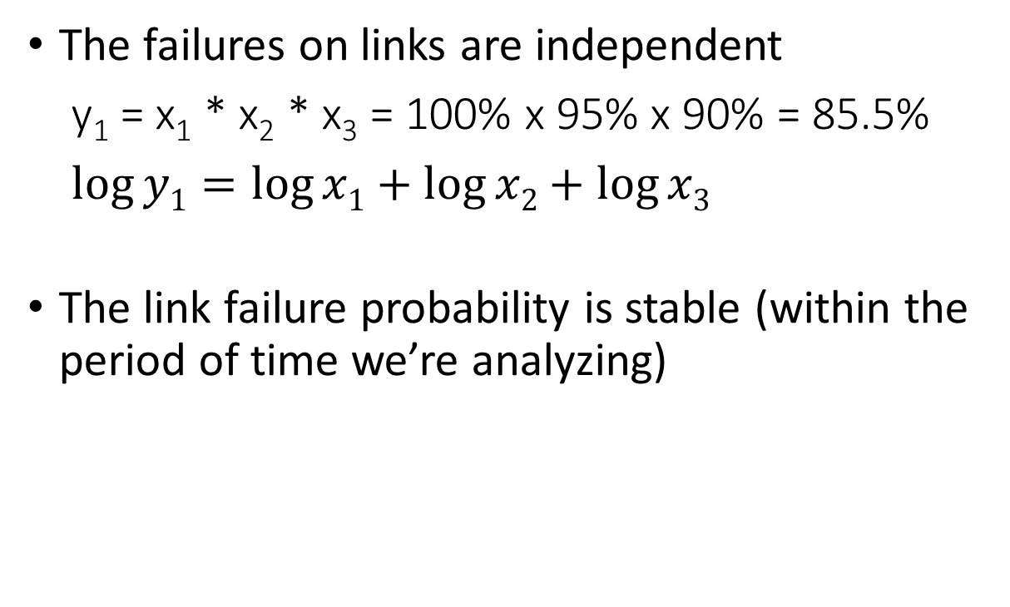
Assumptions
y₁=85.5%
The failures on links are independent
y₁ = x₁ * x₂ * x₃ = 100% x 95% x 90% = 85.5%
$\log{y1}=\log{x1}+\log{x2}+\log{x3}$
The link failure probability is stable (within the period of time we’re analyzing)
x₃=95%
x₂=100%
x₁=90%
Note: both the assumptions can be relaxed. Eventually, we may need to extend these assumptions.
Notes:
take logarithm for both sides
Why log?
Nice linear properties.
It’s very important for us to answer the questions we just asked.
In the following talk, I will continue using the “meaningful” formula since it’s easy to understand and follow.
But please keep in mind that in our real case/evaluation, we use log scale.
Assumption:
The failures on links are independent
The link failure rate is stable in a period of time
The success rate of a path is the probability of not failing on any links

Slide 30
Is it possible to infer link failures from path failures?
The equations we have
y₁= x₁*x₃ = 0.8
y₂= x₁*x₄ = 0.9
y₃= x₂*x₃ = 0.8
y₄= x₂*x₄ = 0.9
y₄ = y₂ * y₃ / y₁
-- y1 = 0.8 -- y2 = 0.9
-- y3 = 0.8 -- y4 = 0.9
X₃ = 0.8
X₄
X₃ = 0.89
X₄ = 0.9
X₃
X₄ = 1
X₁
X₂
X₁ = 1
X₂ = 1
X₁ = 0.9
X₂ = 0.9
Notes:
Emphasize the problem first, to recall the audiences.
The problem we meet is: if we have y1,y2…, can we get the x1, x2,…?
The equations we have are.
From a quick glance, it seems we got 4 equations and 4 unknown variables. It should be easy, however….
Is it the end of the world? Because from such topology we can never get an unique result.

Slide 31
However, in reality
y, x ϵ [0, 1]
Most paths are good
Usually:
y₁= x₁*x₃ = 0.8
y₂= x₁*x₄ = 1
y₃= x₂*x₃ = 0.8
y₄= x₂*x₄ = 1
-- y1 = 0.8 -- y2 = 1
-- y3 = 0.8 -- y4 = 1
X₃ = 0.89
X₄ = 1.11
X₃ = 0.8
X₄ = 1
X₁ = 0.9
X₂ = 0.89
X₁ = 1
X₂ = 1
Notes:
In this case, we have a unique solution.

Slide 32
定理:问题有解的充分必要条件
We proved that:
For a layered graph, there is a unique least squares solution to the paths
if and only if
at least one path with success probability 1 passes each node
Layer 4
Layer 3
Layer 2
Layer 1
Good path
Problematic path
Notes:
Thanks Ze.
Least square solution.
Why we need this?
Explain layered network:
No links within layers.
Probe start from the lowest layer to the highest layer.
This condition is not for general graph.
It is for a layered graph which has some constraints.
Clos network in DC is applicable to this.

Slide 33
分而治之: 故障分类到 链接 或 设备
Notes:
Briefly talk about the devices part.
XXX Remove the node.

Slide 34
理论和实际的距离: 不一致的数据
There is no exact result
y₁=x₁*x₂=0.9, y₂=x₁*x₃=0.8 (x₂ = x₃ = 1) => x₁ = 0.8 or 0.9?
Use least square result (x₁ = 0.85)
Good path constraint is too strong
y₁ = x₁ * x₂ = 1 => x₁ = x₂ = 1
Path during sampling is good =?> links are good
Take an almost 1 probability (x₁ = 1 - Ɛ)
x₁ = ?
x₁ = ?
x₂
x₃ = 1
x₂ = 1
y₁ = 0.9
Good path
y₂ = 0.8
Problematic path

Slide 35
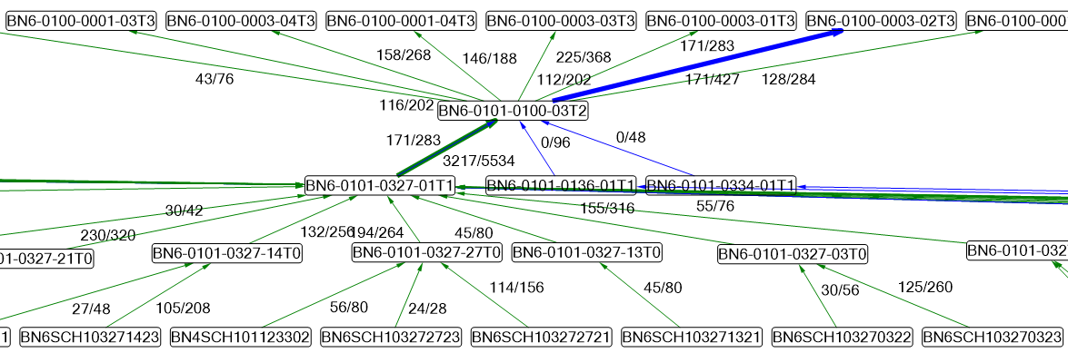
Challenges: false positive
Notes:
Why false positive is annoying?

Slide 36
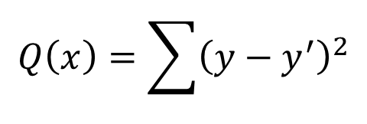
The least square solution
y₁’=x₂*x₃
y₂’=x₁*x₃
y₃’=x₁*x₄
y₄’=x₁*x₅
x₂=x₄=x₅=100%
$$Q\left(x\right)=\sum{{\left(y−y^{′}\right)}^{2}}$$
y₄=1 - 158/268=41%
y₁=1 - 0/144=100%
y₃=1 - 43/76=43%
X₅
y₂=1 - 171/283=39%
X₄
X₃=?
X₁=?
X₂

Slide 37
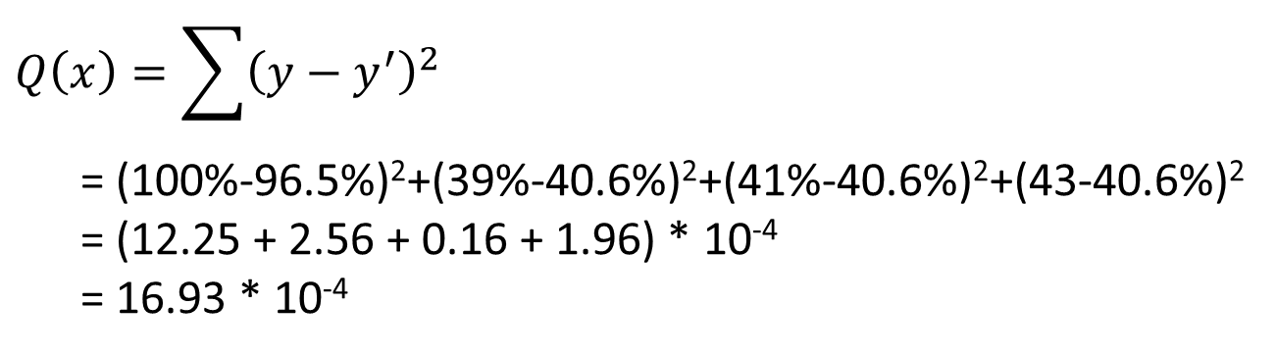
The least square solution
$$Q\left(x\right)=\sum{{\left(y−y^{′}\right)}^{2}}$$
= (100%-96.5%)²+(39%-40.6%)²+(41%-40.6%)²+(43-40.6%)²
= (12.25 + 2.56 + 0.16 + 1.96) * 10⁻⁴
= 16.93 * 10⁻⁴
X₁=40.6% x₃=96.5%
y₁’=x₂*x₃=96.5%
y₂’=x₁*x₃=40.6%
y₃’=x₁*x₄=40.6%
y₄’=x₁*x₅=40.6%
y₁=1 - 0/144=100%
Reason of false positives:
Broken link’s failure probability is not *very* stable (e.g. 39% ~ 43%)
The objective function sometimes want to penalize good links to
achieve better result (smaller error rate)
y₄=1 - 158/268=41%
y₃=1 - 43/76=43%
X₅
X₄
y₂=1 - 171/283=39%
X₃
X₁
X₂

Slide 38
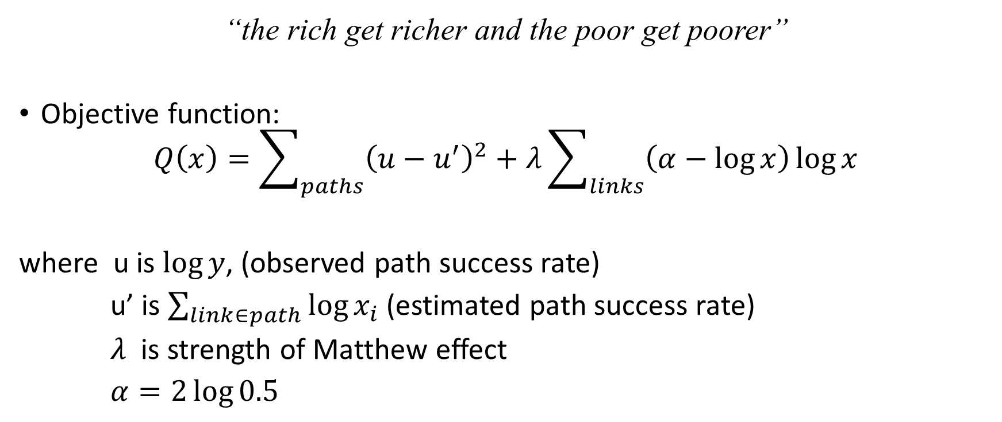
Matthew effect: regularized least square solution
“the rich get richer and the poor get poorer”
Objective function:
$$Q\left(x\right)=\sum_{paths}{{\left(u−u^{′}\right)}^{2}}+λ\sum_{links}{\left(α−\log{x}\right)\log{x}}$$
where u is $\log{y}$, (observed path success rate)
u’ is $\sum_{link∈path}{\log{x_{i}}}$ (estimated path success rate)
$λ$ is strength of Matthew effect
$α=2\log{0.5}$

Slide 39
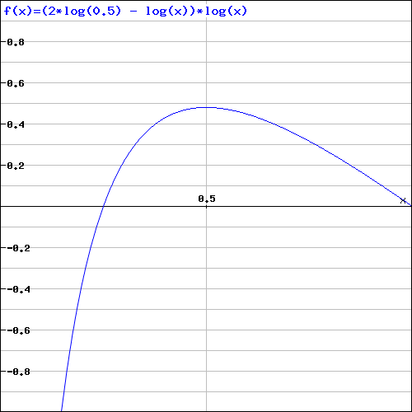
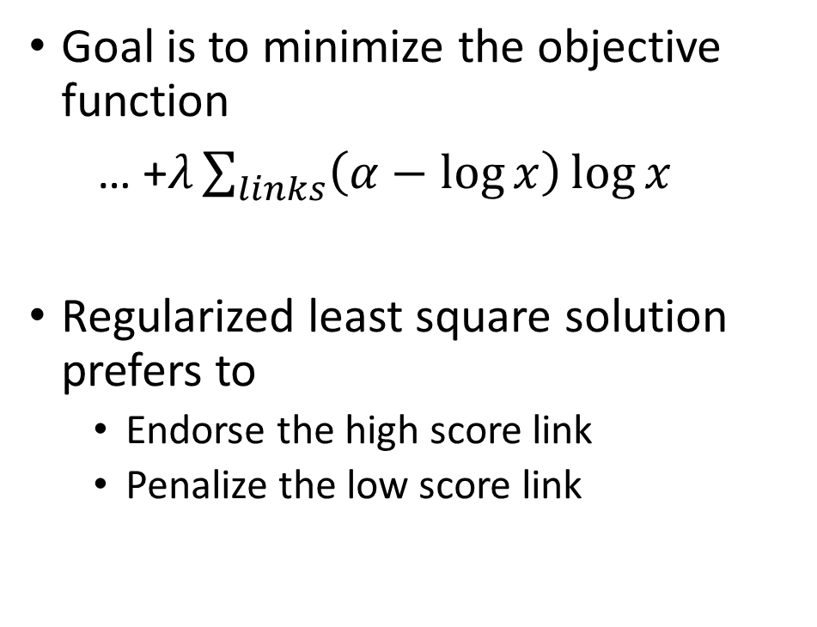
Intuition behind the regularization
Goal is to minimize the objective function
… +$λ\sum_{links}{\left(α−\log{x}\right)\log{x}}$
Regularized least square solution prefers to
Endorse the high score link
Penalize the low score link

Slide 40
Optimization method
Coordinate descent
Stochastic gradient descent
Mathematical solving
We choose coordinate descent
SGD has poorer performance
Mathematical solving needs to consider the [0,1] constraints
Notes:
Should we introduce the CD in detail? Or may be as a backup slides.
analytical solution, we take the derivatives and solve the normal equations from the quadratic progamming problem (linear least squares is a quadratic programming problem)
ackup slides.

Slide 41
Evaluation questions
Does NetBouncer work well?
What’s the effectiveness of NetBouncer’s techniques?
w/ and w/o device failure detection
SGD vs. CD
Others in paper
What’s the performance of NetBouncer processor in reality?

Slide 42
Evaluation setup
The simulation:
3-layer Clos network with 2.8K switches (48 ports), 27.6K servers and 82.9K links
Numbers are average of 10 executions.
Loss rate
x_{i} for faulty link/dev: [0, 0.98]; x_{i} for normal link/dev: [0.999, 1]
0.1%/1%/10% faulty links and 10 faulty devices

Slide 43
NetBouncer performance
In simulations
Faulty link% | #FN | #FP
0.1% | 0 | 0
1% | 0 | 0
10% | 0.3 | 0.2
In practice
No false positive (operator-friendly)
Few false negatives

Slide 44
What’s the effectiveness of NB’s techniques?
With and without device failure detection
Faulty link% | w/o DFD |  | w/ DFD
 | #FN | #FP | #FN | #FP
0.1% | 135.3 | 0 | 0 | 0
1% | 164.0 | 0 | 0 | 0
10% | 123.3 | 0 | 0.3 | 0.2
SGD vs. CD
Optimization Method | Learning rate | #round | Time(s)
CD | - | 4 | 14.8
SGD-lazy | 0.001 | 145 | 513.3
SGD-lazy | 0.005 | 45 | 157.5
SGD-lazy | 0.01 | 161 | 569.9
Notes:
???

Slide 45
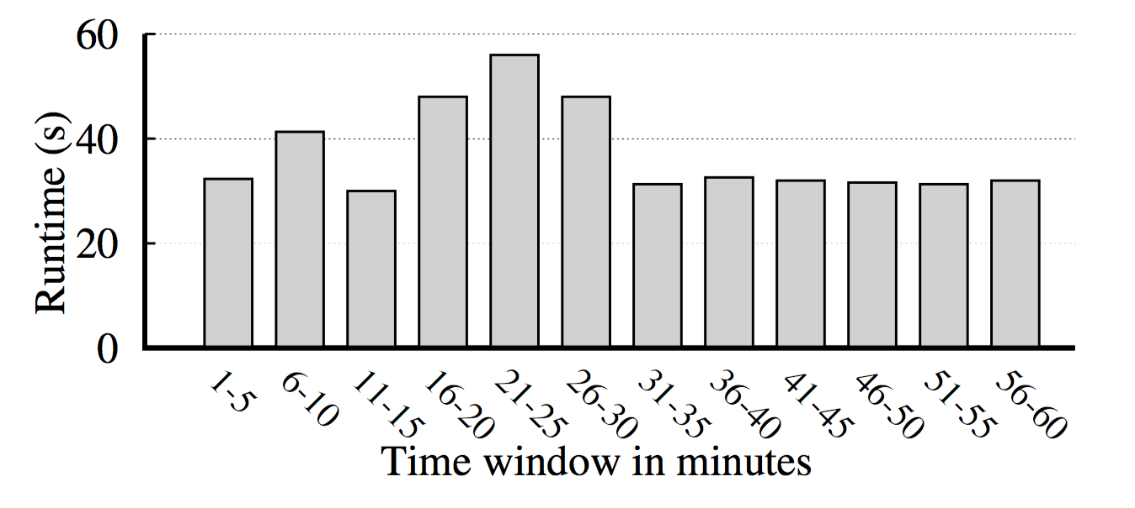
NetBouncer processor runtime
Xeon E5 2.4GHz CPU with 128GB memory
1 hour trace from 2016/11/5 (130GB)

Slide 46
Related work
Network tomography
Internet failure localization: NetScope, LIA, NetQuest
Heuristic algorithm: Tomo, deTector
Other failure localization approaches
Inaccurate: Pingmesh, NetSonar, NetNorad
Incompatible: LossRadar, Trumpet, Passive probing
Explicit path probing
XPath and other source routing
Probing plan design
Focus on minimizing number of paths

Slide 47
利用系统的大规模解决大规模带来的挑战
建立更完整全面的观察，而不是单一的点
利用统计学，特定领域的知识，以及合适的人工智能算法来发现并定位问题

Slide 48
人工智能系统的新特征
深度学习对网络连接的敏感度
硬件加速，多样异构系统

Slide 49
深度学习任务调度的特殊属性
多GPU任务的分配策略对性能有很大影响 （即使在同一台服务器上也可以多达30% 性能损失）
有些类型的深度学习任务会互相干扰 （多达40%的性能损失）
Notes:
Experiment done with Tensorflow r1.2 benchmark on p100 machine

Slide 50
对数据中心网络设计的重新思考
从以服务器为单位到以设备为基本单位
统一的网络：从服务器之间的连接到服务器内的连接
安全、性能和软硬件结合的设计和实现

Slide 51
结束语
智能云端时代从根本上是大网络系统的时代
网络、系统和智能的融合是必然的趋势
硬件多样性和异构型
网络系统的大规模和高复杂性+人工智能处理高复杂性上的优势
面对新的需求和挑战，系统网络研究急需新的理论、协议、原理和方法论
人工智能对网络系统的挑战

